Slide 1
REQUIREMENTS GATHERING
GROUP 22

Slide 2
OUTLINE
Introduction
Reviewing Existing Mobile Disaster Management System (DMS)
Identify Stakeholders
Requirement Gathering Approaches
Manage Requirements Changes

Slide 3
1. INTRODUCTION
Requirement gathering is the process of collecting information about what the stakeholders wants.

Slide 4
2. Review Existing Mobile DMS
Overview of mobile based disaster management system.
Advantages of mobile based disaster management system.
Limitations of existing mobile based disaster management system.
Advantage of our mobile disaster management system over the existing ones.

Slide 5
3. Identify Stakeholders
Stakeholders in a disaster management system are the individuals, groups, or organizations that have a stake in its success or failure.

Slide 6
3. Identify Stakeholders
CITIZENS
E. RESPONDERS
NGO’S
STAKEHOLDERS
MEDIA
GOVERNMENT AGENCIES

Slide 7
Roles Of Our Stakeholders
Citizens: Prepared, informed, engaged for effective response.
Emergency Responders: Trained, equipped, frontline heroes saving lives.
Government Agencies: Plan, mitigate, lead recovery for resilient communities.
NGOs: Humanitarian aid, relief supplies, long-term support for rebuilding.
Media: Inform, raise awareness, report for prepared and informed communities.

Slide 8
4. Requirement Gathering Approaches
Our requirement gathering process involved 4 methods:
Web-based Survey
Document Review
Citizen interview
Brainstorming

Slide 9

Web-base Survey Form
LINK : https://forms.gle/7ctGEsQNciEiSxNv8
Quick & Wide Reach, Secure Data on Awareness & Mitigation.

Slide 10
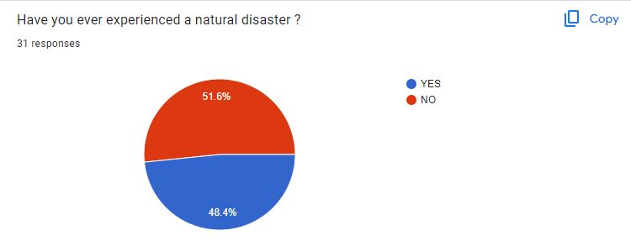
Data from the survey

Slide 11
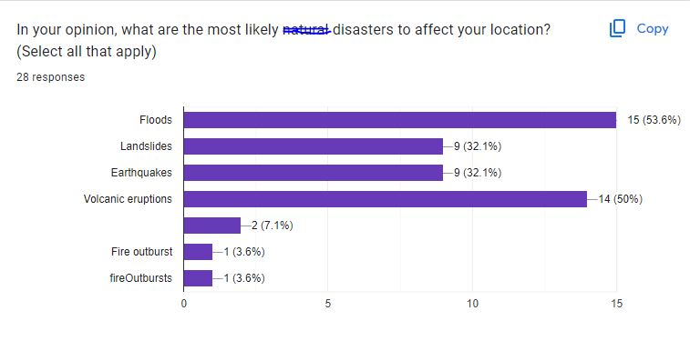
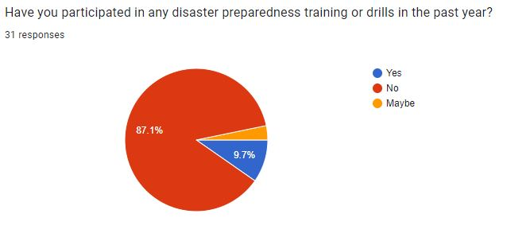
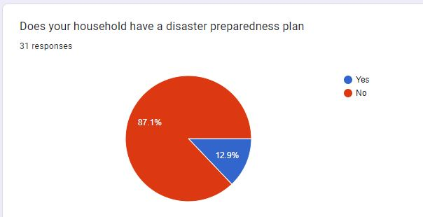

Slide 12
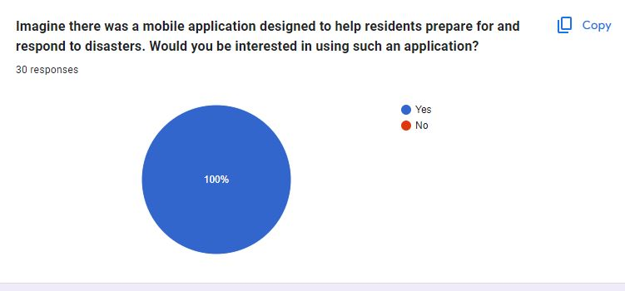
100% Acceptance of the Application

Slide 13
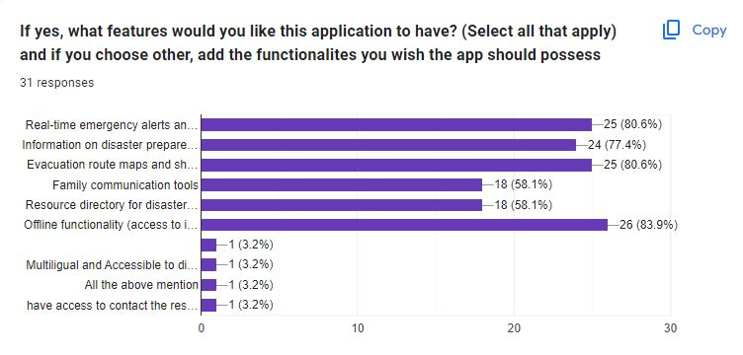

Slide 14

Document Review and Research
Sources
Local Emergency Response Plans:
https://floodready.vermont.gov/update_plans/local_emergency_operations
https://www2.gov.bc.ca/assets/gov/public-safety-and-emergency-services/emergency-preparedness-response-recovery/local-government/em_planning_guide_for_la_fn.pdf
Community Risk Assessments:
https://riskassessment.strategicfire.org/wp-content/uploads/2016/03/Community-Risk-Assessment-Guide-v1.5.pdf

Slide 15
Data collected from the document review and research
Early Warning Systems:
Risk Assessment & Hazard Mapping.
Disaster Response & Coordination
Community Vulnerability

Slide 16

Citizen Interview
User Feedback and Support
Offline functionality
Multi-Language Support
Report Disaster
Evacuation Routes
Request Help
Alerts and notifications
Receive alerts offline (SMS)
Usability

Slide 17

Brainstorming
After getting the needs of our stakeholders it was then time to put the team together and brain storm having their needs in mind.

Slide 18
Brainstorming
Real-time alert and notification (Preparation & Response)
Resource Management (Preparation, Response, Mitigation)
Communication (Response, Recovery, Mitigation)
Geospatial data and mapping services (Response)
Incident reporting (Response)
Damage assessment (Response)
Disaster detection (Mitigation)

Slide 19
5. Manage Requirements Changes
Change Request Submission
Communication and Dissemination
Ongoing Monitoring and Evaluation

Slide 20
THE END!!!

